Slide 1
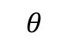
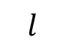
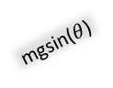
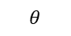
$$θ$$
$$l$$
mgsin($θ$)
$$θ$$
mg
Figure 1. Massless string attached to a bob. The string is under tension due to the force of gravity.

Slide 2
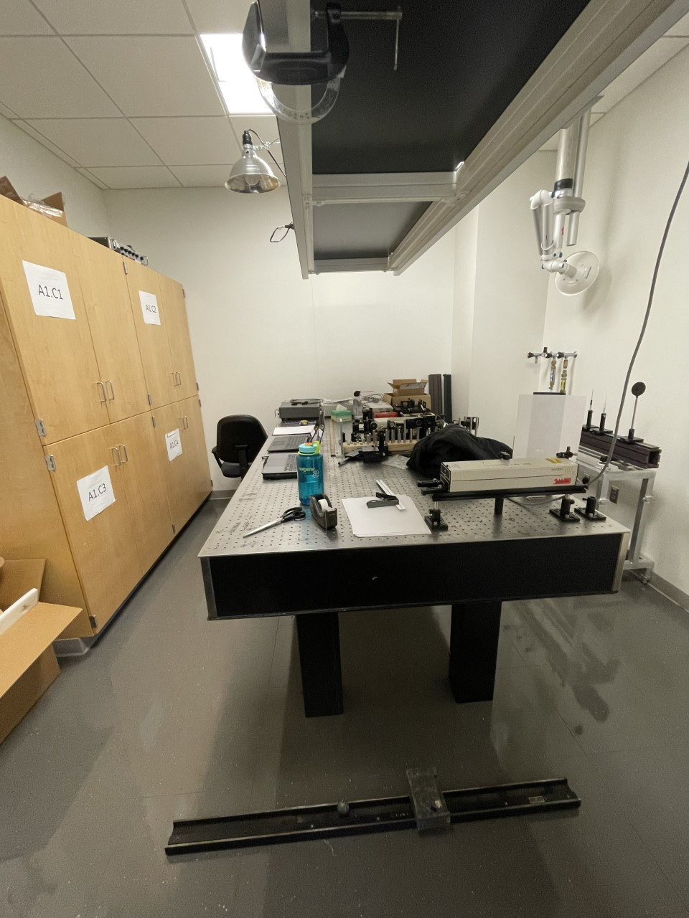
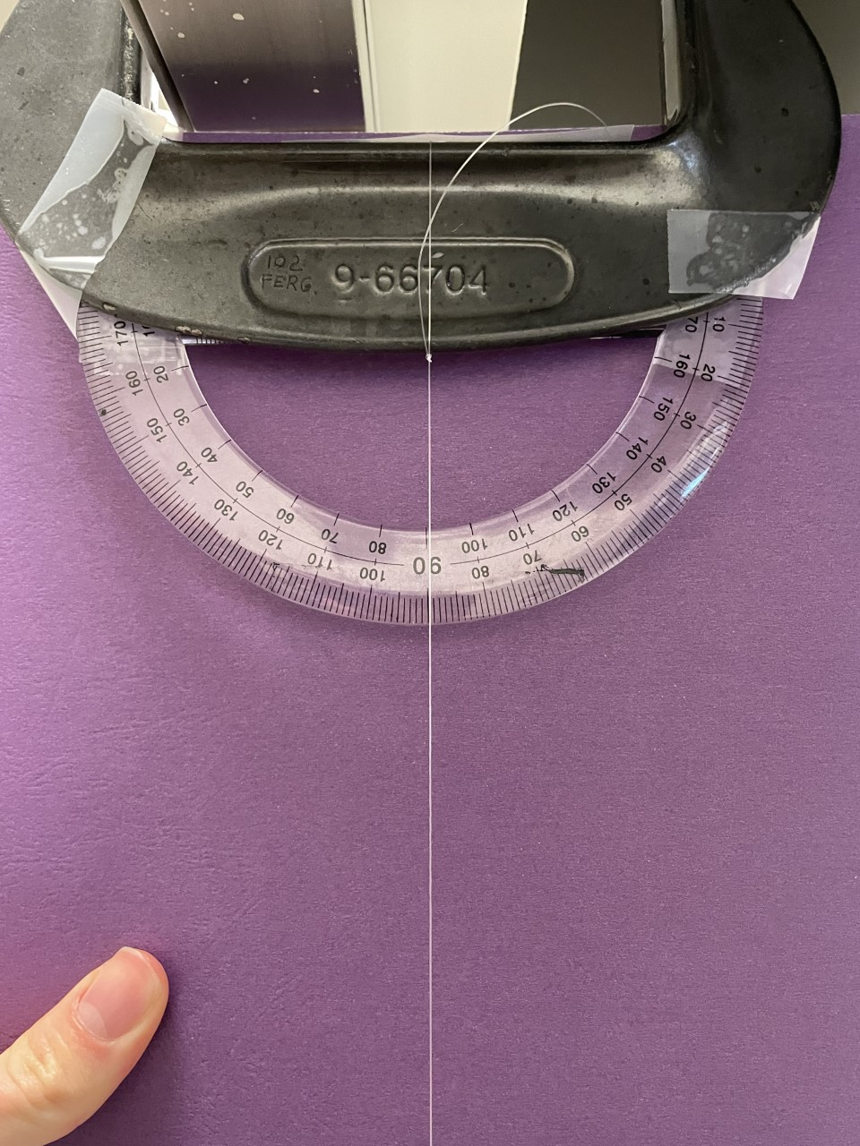
a
Clamp
b
Protractor
Fishing
line
Figure 2a. Here is our full experimental set up. The top features a C-clamp where the string and protractor are attached to. The bottom is where our bob, rail, and lead brick rest.
Figure 2b. Picture of the protractor with our rest position of the pendulum at 0 degrees. For small angles, the knot did not move.
Bob
Lead Brick
Guide Rail

Slide 3
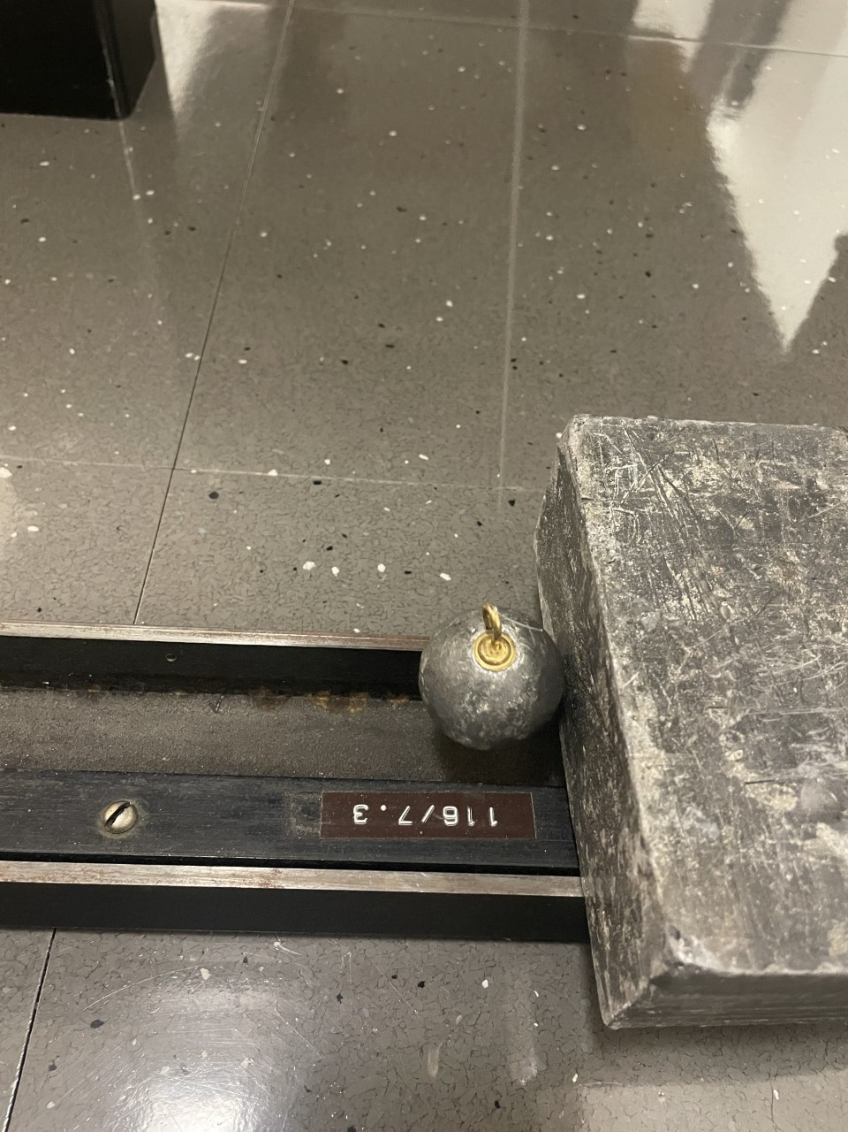
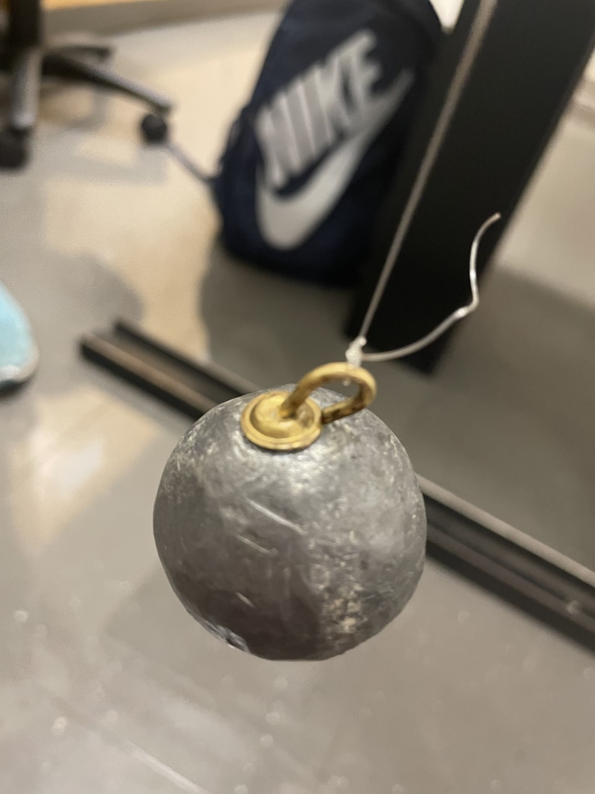
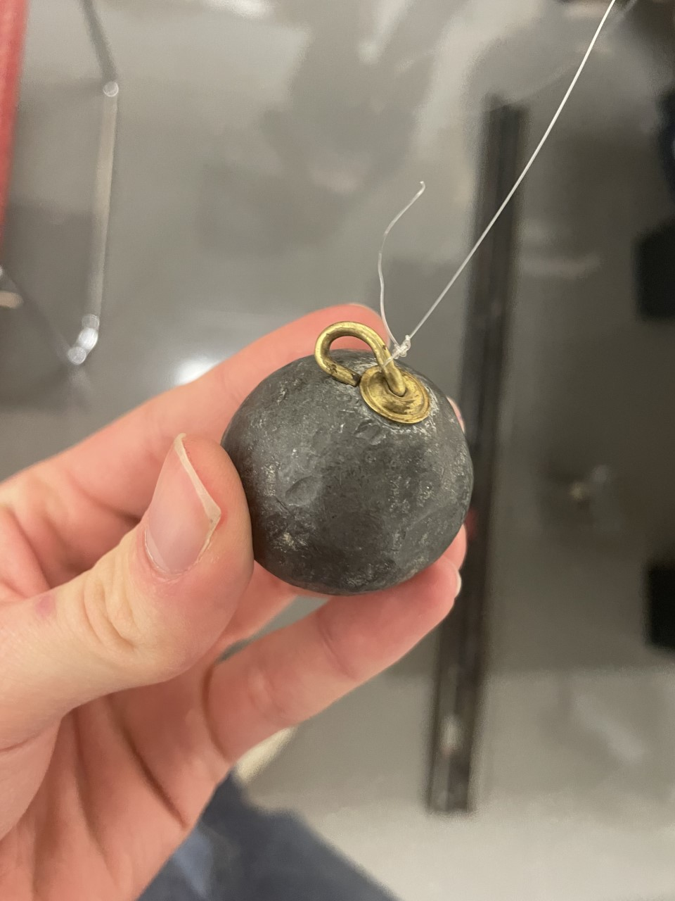
TIME
Figure 3. Shows the evolution of our hook length. The last picture shows the hook after it crashed into the wall from being releasing 90 degrees. Also, the first picture highlights what max amplitude looks like after one oscillation.

Slide 4
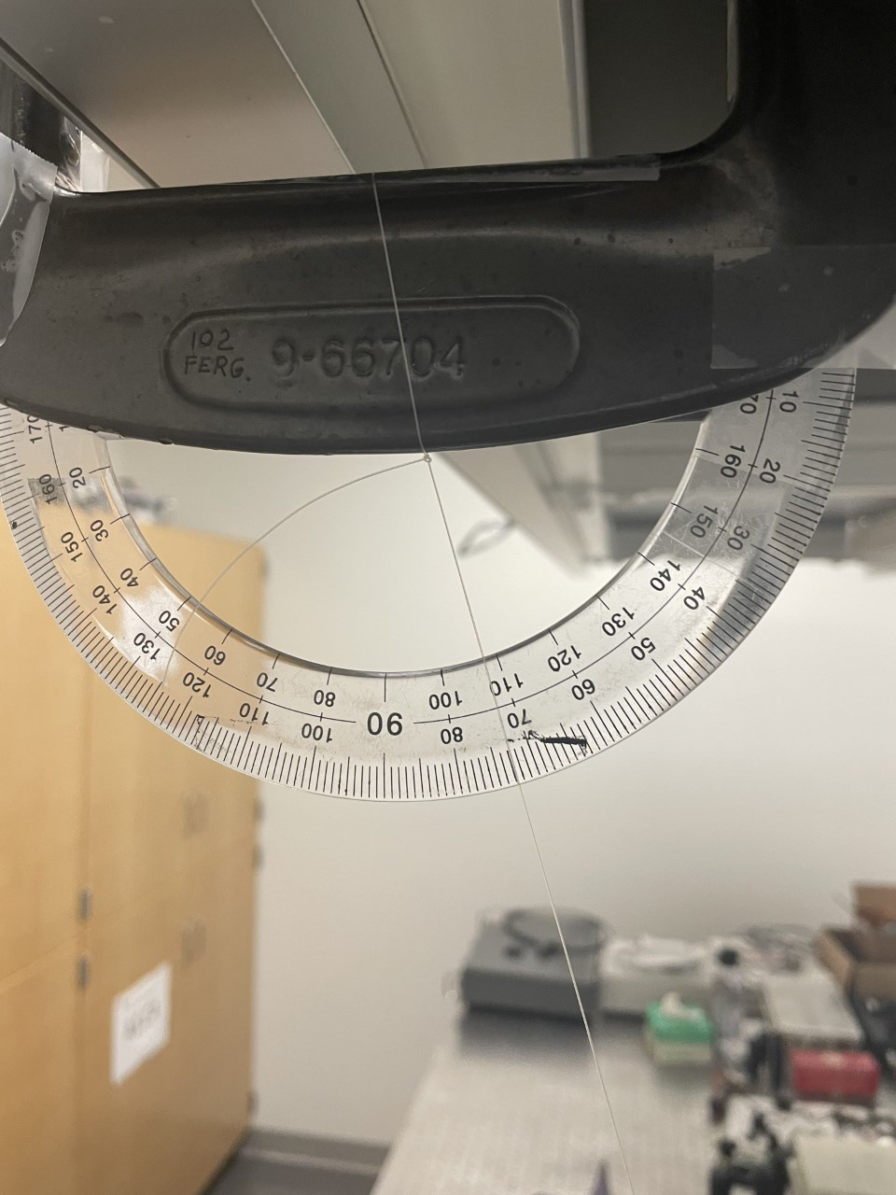
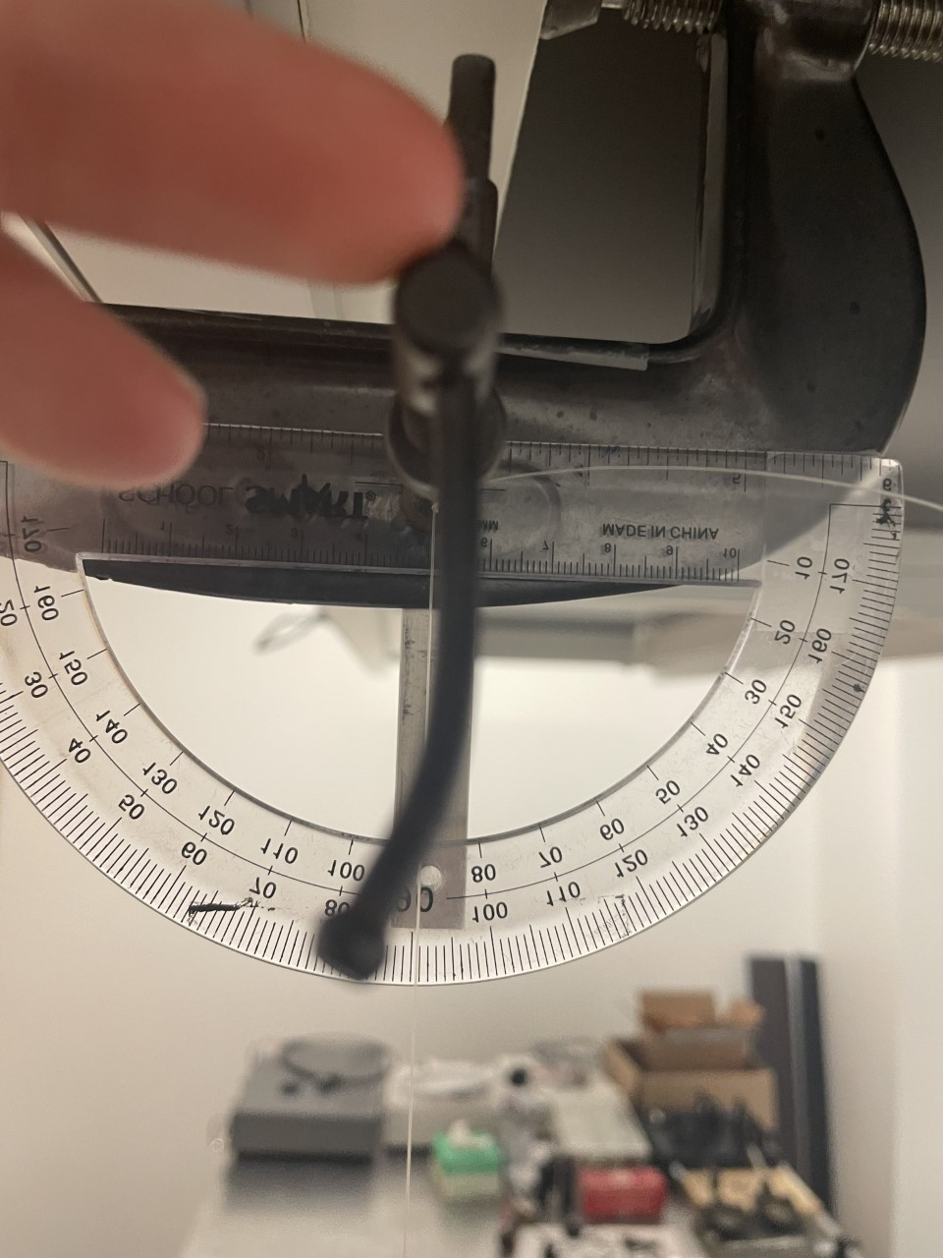
Figure 4. On the left you can see the knot slipping and moving along the C-clamp. Notice also that the center of the protractor is not in line with the knot so it would be impossible to make accurate angle readings. On the right, is our new set up that fixes these issues.

